Slide 1

Discovery Days Hack
Welcome & Intros
John Manaloto
Daniel Wang
Cloud Solution Architect
Cloud Solution Architect

Slide 2
Microservices in Azure Kick-off
Discovery Days Hack
January 17, 2019

Slide 3
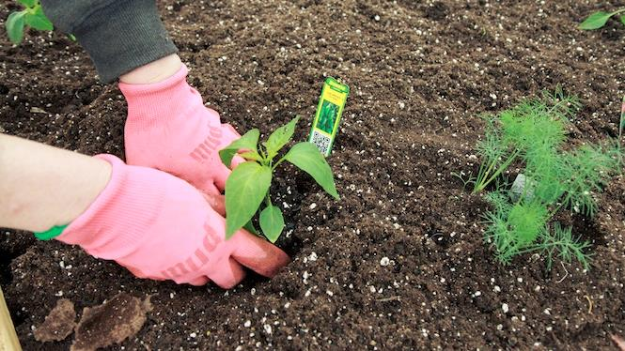
You will get your hands dirty
Notes:
You only get out what you put in, don't be lazy.
Knowledge Retention through Pain and Discomfort

Slide 4
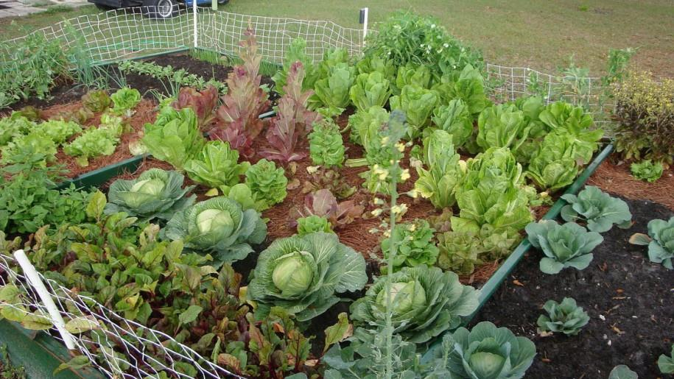
*results may vary
Notes:
You might not grow a garden like this… but at least you can learn while trying.

Slide 5

Logistics
Notes:
And now we’ll cover logistics…

Slide 6
Student Guide
Please download your student guide from here:
aka.ms/msoa-challenges

Slide 7
Format
aka.ms/msoa-challenges
Challenges are cumulative, building upon each other.
Establish Confidence – start small and simple (think hello world)
Build Competence – by having successively more complex challenges
Challenges are NOT step-by-step hands on labs!
No “clicking here” or “copy n pasting there”
Challenge definitions are short. A couple of sentences or bullet points stating the end goal(s) and perhaps a hint at the skill(s) needed.
You MUST work together as a team to figure out how to complete them!

Slide 8
Format
aka.ms/msoa-challenges
For each challenge we will deliver a ”mini-lecture” explaining concepts in it.
We’ll review results for each challenge when it looks like a majority of folks have completed the challenge
Don’t be beholden by the clock!
Move quickly or take it slow.
Your proctors are here to help you.

Slide 9
Proctors
aka.ms/msoa-challenges
You will have proctors through-out the whole hack.
Use them! But don’t expect them to give you all the answers.
Get to know your proctor, their likes and dislikes...
All the better to find a bribe that works!
Notes:
Keep the teams working as teams!
Encourage all to “learn from” and “share with” each other!
If you observe individuals racing ahead, encourage them to help those who are behind.
Encourage attendees to use their team’s channel on MS Teams to collaborate/share info!
Unblock teams who get stuck
Encourage team members to unblock each other first!
Provide hints, but not answers
If you observe individuals stuck for a while, help them get moving so they don’t lose interest.
Provide hints/pointers to the teams on how to solve problems & where to find information.
Use the answers/solutions in the proctor’s guide, but don’t share with the attendees
Proctor’s guide won’t be comprehensive. As SMEs, proctors should use their knowledge to help with solution hints/ideas.
Notify the emcee of unexpected blockers that arise during the event so they can be communicated to all, and recorded for future reference.

Slide 10
Tooling
aka.ms/msoa-challenges
You can use any tooling you want, but we strongly encourage (and will only support the following):
Azure Cloud Shell
Azure CLI in the Cloud Shell
Azure Portal

Slide 11
Finding Answers
aka.ms/msoa-challenges
Search engines are your friend! Azure is a hot technology and much ink has been spilled on it.
The Azure docs are your best bet.
Many of the related open source projects used here have top notch documentation!

Slide 12

And now death by Power Point…

Slide 13
And now death by Power Point… (just kidding!)

